Slide 1
STATIC VARIABLES, METHODS AND BLOCK
Prepared By: Dimple Bohra

Slide 2
Java static keyword
The static keyword in Java is used for memory management mainly. We can apply java static keyword with variables, methods, blocks and nested class. The static keyword belongs to the class than an instance of the class.
The static can be:
Variable (also known as a class variable)
Method (also known as a class method)
Block
Nested class

Slide 3
Java static variable
If you declare any variable as static, it is known as a static variable.
The static variable can be used to refer to the common property of all objects (which is not unique for each object), for example, the company name of employees, college name of students, etc.
The static variable gets memory only once in the class area at the time of class loading.

Slide 4
Advantages of static variable
It makes your program memory efficient (i.e., it saves memory).
Example without static
class Student{
int rollno;
String name;
String college=“VESIT";
}
*Java static property is shared to all objects.
Notes:
Suppose there are 500 students in my college, now all instance data members will get memory each time when the object is created. All students have its unique rollno and name, so instance data member is good in such case. Here, "college" refers to the common property of all objects. If we make it static, this field will get the memory only once.

Slide 5
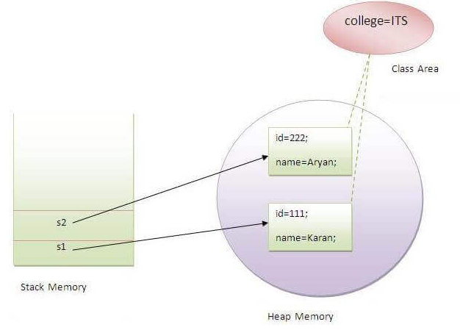
TestStaticVariable1.java

Slide 6
Java static method
If you apply static keyword with any method, it is known as static method.
A static method belongs to the class rather than the object of a class.
A static method can be invoked without the need for creating an instance of a class.
A static method can access static data member and can change the value of it.
Programs on static method

Slide 7
Restrictions for the static method
There are two main restrictions for the static method. They are:
The static method can not use non static data member or call non-static method directly.
this and super cannot be used in static context.

Slide 8
class A
{
int a=40;
public static void main(String args[])
{
System.out.println(a);
}
}

Slide 9
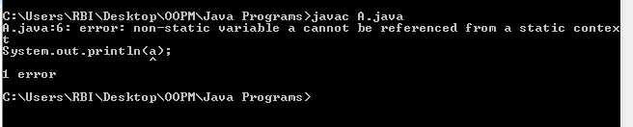
class A
{
int a=40;
public static void main(String args[])
{
System.out.println(a);
}}
****Compile time error

Slide 10
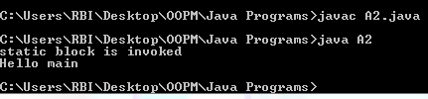
Java static block
Is used to initialize the static block
It is executed before the main method at the time of classloading.
Example of static block
class A2
{
static
{
System.out.println("static block is invoked");
}
public static void main(String args[])
{
System.out.println("Hello main");
}
}

Slide 11
PASSING AND RETURNING OBJECTS
Programs
Although Java is strictly pass by value, the precise effect differs between whether a primitive type or a reference type is passed.
When we pass a primitive type to a method, it is passed by value. But when we pass an object to a method, the situation changes dramatically, because objects are passed by what is effectively call-by-reference.
In java, a method can return any type of data, including objects.
9-<number>
Notes:
Objects can be passed to methods as arguments.
Java passes all arguments by value.
When an object is passed as an argument, the value of the reference variable is passed.
The value of the reference variable is an address or reference to the object in memory.
A copy of the object is not passed, just a pointer to the object.
When a method receives a reference variable as an argument, it is possible for the method to modify the contents of the object referenced by the variable.

Slide 12


